Slide 1
HTTP AJAX Requests
JSON

Slide 2
Asynchrony
Asynchronous Programming vs Parallel Programming

Slide 3
Asynchronous Code
In synchronous programs, if you have two lines of code (L1 followed by L2), then L2 cannot begin running until L1 has finished executing.
In asynchronous programs, you can have two lines of code (L1 followed by L2), where L1 schedules some task to be run in the future, but L2 runs before that task completes.

Slide 4
Callbacks
“Each function gets an argument which is another function that is called with a parameter that is the response of the previous action.”

Slide 5
HTTP - Hypertext Transfer Protocol
HTTP is the foundation of data communication for the World Wide Web. HTTP is the protocol that allows for sending documents back and forth on the web.

Slide 6
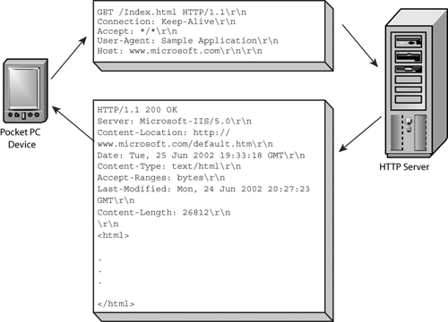
HTTP - Hypertext Transfer Protocol

Slide 7
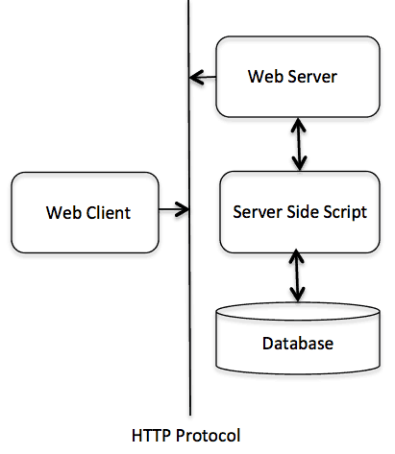
HTTP - Hypertext Transfer Protocol

Slide 8
HTTP - Hypertext Transfer Protocol
HTTP is based on the client-server architecture model and a stateless request/response protocol that operates by exchanging messages across a reliable TCP/IP connection.

Slide 9
HTTP Request
An HTTP client sends an HTTP request to a server in the form of a request message.
The request method indicates the method to be performed on the resource identified by the given Request-URI

Slide 10
HTTP Request - Methods
GET The GET method is used to retrieve information from the given server using a given URI. Requests using GET should only retrieve data and should have no other effect on the data.
POST A POST request is used to send data to the server, for example, customer information, file upload, etc. using HTML forms.

Slide 11
HTTP Response
After receiving and interpreting a request message, a server responds with an HTTP response message.

Slide 12
HTTP Response - Status
1 | 1xx: Informational It means the request was received and the process is continuing.
2 | 2xx: Success It means the action was successfully received, understood, and accepted.
3 | 3xx: Redirection It means further action must be taken in order to complete the request.
4 | 4xx: Client Error It means the request contains incorrect syntax or cannot be fulfilled.
5 | 5xx: Server Error It means the server failed to fulfill an apparently valid request.

Slide 13
JSON - JavaScript Object Notation
A language-agnostic lightweight data-interchange format

Slide 14
JSON - JavaScript Object Notation
JSON is built on two structures:
A collection of name/value pairs. In various languages, this is realized as an object, record, struct, dictionary, hash table, keyed list, or associative array.
An ordered list of values. In most languages, this is realized as an array, vector, list, or sequence.

Slide 15
XHTTP Rеquest - Get Example
var xmlHttp = new XMLHttpRequest(); xmlHttp.onreadystatechange = function() { if (xmlHttp.readyState == 4 && xmlHttp.status == 200) console.log(xmlHttp.responseText); } xmlHttp.open("GET", 'https://ghibliapi.herokuapp.com/films/58611129-2dbc-4a81-a72f-77ddfc1b1b49', true); // true for asynchronous xmlHttp.send(null);

Slide 16
Fetch API - GET Example
fetch('https://ghibliapi.herokuapp.com/films/58611129-2dbc-4a81-a72f-77ddfc1b1b49', { method: 'get' }) .then(function (response) { return response.json() .then( function (data) { console.log(data); } ) }).catch(function (err) { // Error :( console.log('bebebe'); });

Slide 17
Public APIs
https://github.com/toddmotto/public-apis

